Slide 1

Dynamic pricing strategies for fitness classes based on demand, time, and location
BY MANSHOO GULATI

Slide 2


OBJECTIVE
The primary objective of this project is to implement dynamic pricing strategies for fitness classes at Cult Fit. The goals include understanding demand patterns by analyzing historical booking data to identify trends and peak times, and determining the factors affecting class popularity. Using insights from data analysis, we aim to develop pricing algorithms that consider variables such as demand, time, class type, and location. These algorithms will be tested on historical data to simulate and validate pricing adjustments, evaluating their effectiveness in increasing revenue and balancing demand. Ultimately, the project seeks to optimize revenue by increasing prices during high-demand periods and offering discounts during low-demand times, while enhancing customer experience by providing competitive prices based on real-time demand and ensuring fair pricing across different locations and class types.

Slide 3
DATA ANALYSIS
OVERVIEW
Historical booking data : Analyzed past booking patterns to understand customer behaviour.
Price Elasticity modelling : Assessed how change in prices affect booking trend
Demand Forecasting - Predicted future booking trends to optimise pricing
TOOLS USED –
Python – for data analysis and modelling
Prophet – for accurate demand forecasting
Seaborn and matplotlib – for clear and insightful data visualization
Excel – To make some minor changes to the dataset
Chatgpt – for gaining information about the topics

Slide 4
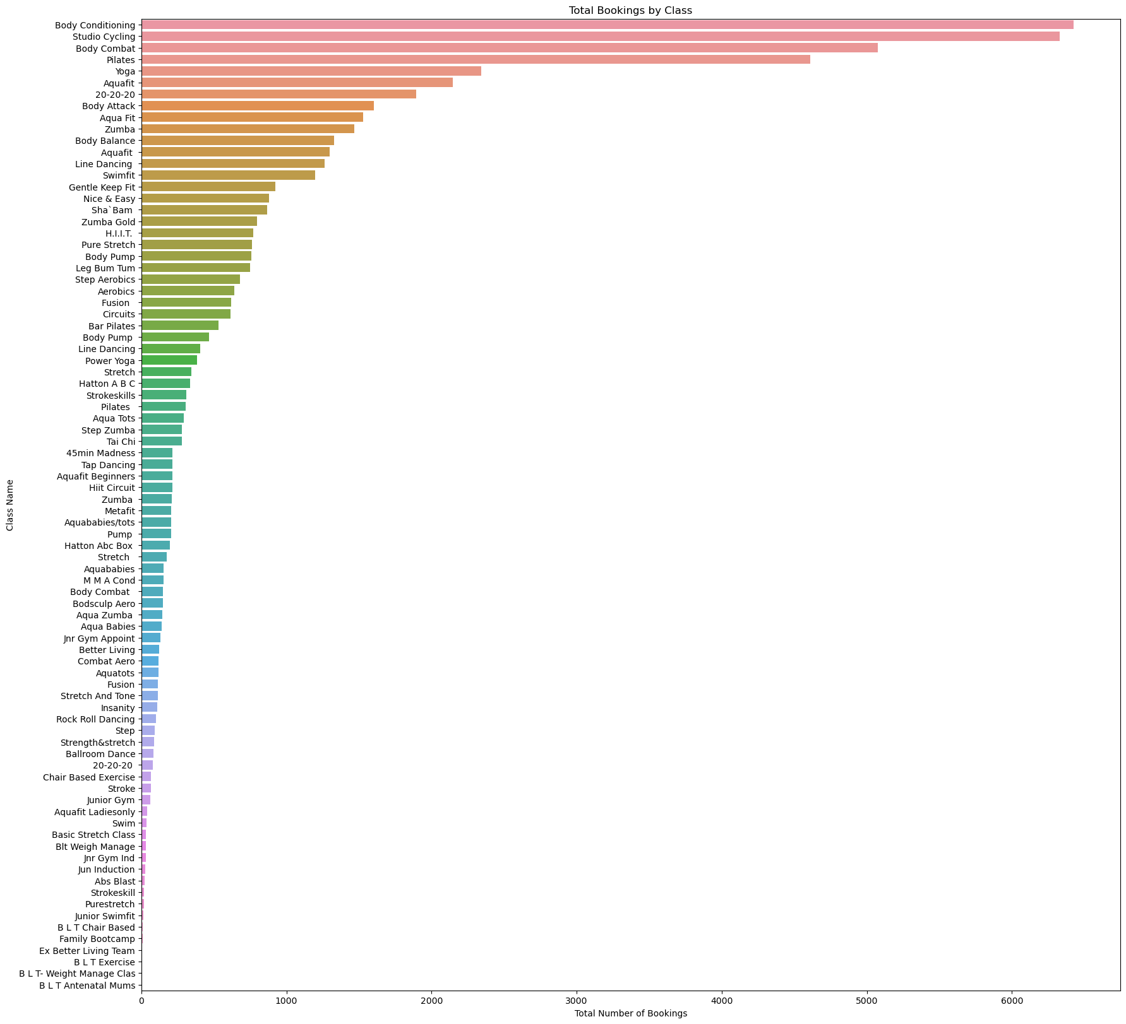
FINDINGS
Body conditioning , studio cycling , body combat , pilates and yoga are the most popular classes booked.
BLT antenatal mums , BLT weight manage class , BLT exercise , Ex better living team and Family bootcamp are the least classes booked.

Slide 5
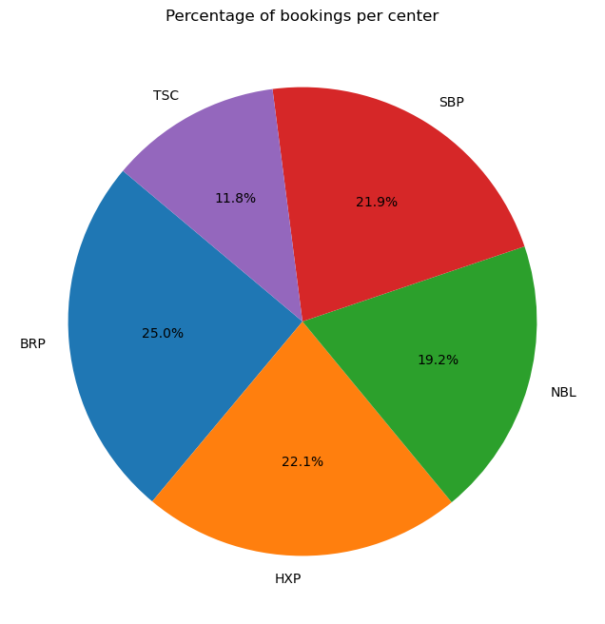
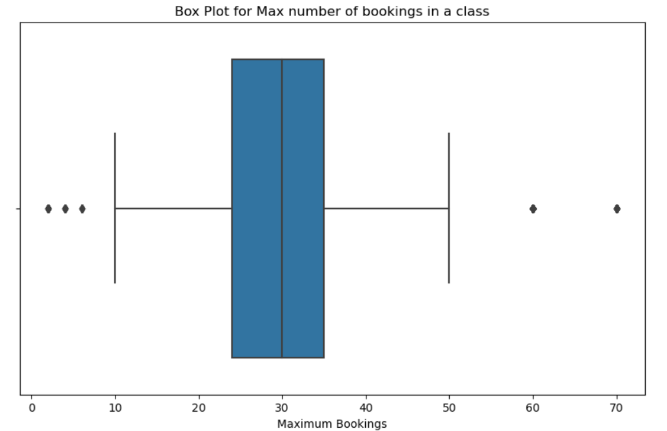
FINDINGS
“BRP” centre has the most percentage of bookings while “TSC” has the least percentage of bookings.
Mostly the classes can have maximum bookings of 25-35. Moreover , the maximum bookings are also under 10 , 60 and 70 which will be considered as the outliers.

Slide 6
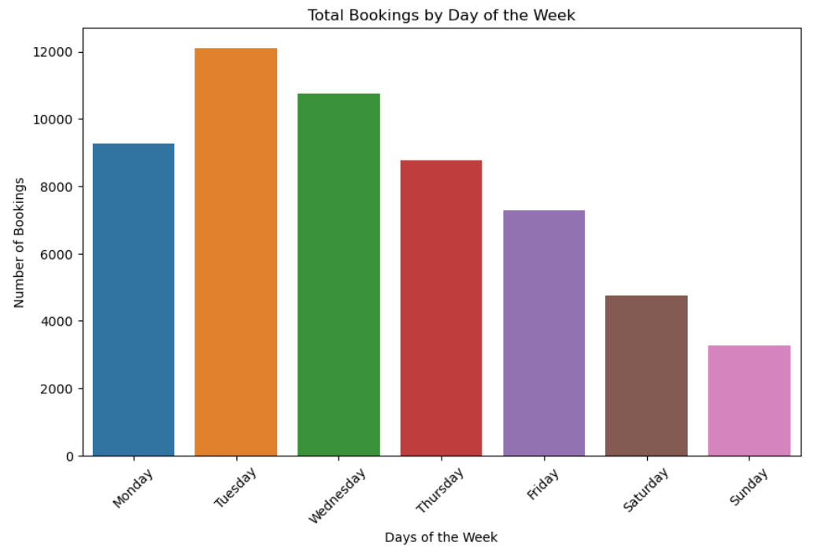
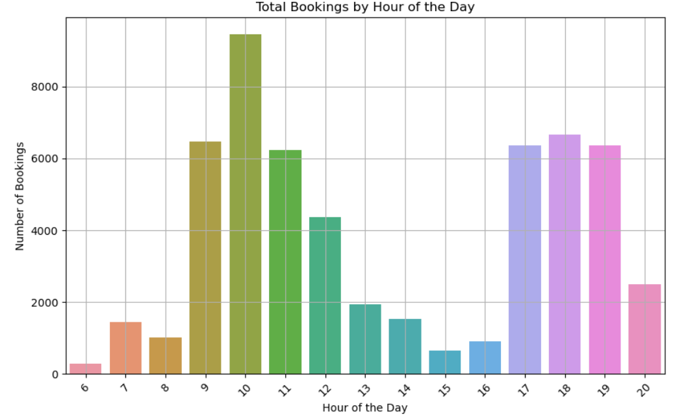
FINDINGS
Weekdays are more crowded than the weekends.
Mornings (9am-12pm) and evenings (5-7pm) are more crowded than the early mornings and noon time.

Slide 7
DYNAMIC
PRICING
Dynamic pricing involves real-time price adjustments based on demand, time, popularity, and other factors.
DYNAMIC PRICING DEFINING RULES :
Demand based pricing – Prices dynamically adjusting based on real time demand to maximize revenue.
Time based pricing – Price adjustments during peak and off peak hours to align with customer preferences and increase profitability.
Popularity based pricing – High demand classes are priced premium to leverage increased demand and popularity.
Location based pricing – Tailoring prices according to location based demand patterns to boost revenue and profitability.

Slide 8
PRICING RULES
Demand based pricing–
High Demand - When the demand for a class is higher than the average demand, increase the price by a certain percentage (e.g. 10-20%).
Low Demand - When the demand for a class is lower than the average demand, decrease the price by a certain percentage (e.g. 10-20%).
Time based pricing –
Peak times - Using historical booking data to identify peak hours and days. Increasing the price (15-20%)
during these times.
Off peak times - Identifying off-peak hours and applying a lower pricing rate (10-15%) to encourage bookings.
Class popularity based pricing –
Popular classes - Tracking booking rates, customer reviews, and repeat attendance for each class. Applying
a premium price (10-15%) for the most popular classes.
Non popular classes - Slightly decreasing the price for less popular classes for encouraging attendance.
Location based pricing –
High demand locations – Analyzing booking patterns across different locations and increasing prices (10-15%) in locations with consistently high demand and limited competition.
Low demand locations – Analyzing booking patterns and competition benchmarks and decreasing prices (10-15%) in low demand areas.

Slide 9
BENEFITS OF DYNAMIC PRICING
INCREASED REVENUE –
Higher revenue per class - During high-demand periods, increasing prices captures additional revenue from customers willing to pay more. Conversely, lowering prices during low-demand times can attract more customers, filling up otherwise empty slots. This balance ensures that each class is generating maximum possible revenue.
Increased overall company revenue - . By ensuring that classes are fully booked at the best possible rates, the company can see a substantial increase in its total income. This approach not only maximizes revenue from each session but also encourages higher attendance rates, contributing to the company's financial growth.

Slide 10
BENEFITS OF DYNAMIC PRICING
ENHANCED CUSTOMER SATISFACTION –
Fair and transparent pricing - Customers appreciate transparency in pricing. By clearly communicating the reasons behind price variations (such as demand, time of day, and class popularity), customers are more likely to perceive the pricing as fair. This transparency builds trust and loyalty, which can lead to repeat business and positive word-of-mouth referrals.
Better alignment with customer demand - During off-peak times or for less popular classes, lower prices make the classes more accessible, attracting more customers. Conversely, during peak times or for highly popular classes, customers understand and expect higher prices due to the higher demand. This alignment increases customer satisfaction by providing value for their money.

Slide 11
BENEFITS OF DYNAMIC PRICING
COMPETITIVE ADVANTAGE –
Dynamic reason to market change - The ability to adjust prices in real-time based on market conditions gives the company a significant competitive edge. Whether it’s a sudden surge in demand or a drop due to external factors, dynamic pricing allows the company to respond quickly and effectively, maintaining optimal occupancy and revenue levels.
Optimal use of data analytics - The analytical approach not only enhances pricing accuracy but also provides insights into customer behavior, market trends, and competitive dynamics. The continuous feedback loop from data analytics helps refine pricing strategies over time, keeping the company ahead of the curve.

Slide 12
BUSINESS
RECOMMENDATIONS
DEVELOP AND IMPLEMENT ALGORITHMS –
Create dynamic pricing algorithms based on analyzed data.
Integrate these algorithms into the current booking system.
MONITOR AND REFINE-
Continuously track performance metrics.
Adjust pricing strategies as needed based on real-time data
ENHANCE CUSTOMER COMMUNICATION –
Clearly communicate the reasons behind price changes to maintain transparency and trust.

